Slide 1
Object detection system using OpenCV and ROS
Team mates:
Kavish Mehta
Prem Sharan
Shree Varshan
Abishek R

Slide 2
Overview
The project dealt with the following things :
Creating a 4 wheeled robot with USB Camera
Spawning the 4 wheel robot in a simulation environment
Visualizing the camera feed in rqt
Performing Real-time object detection using Open-CV and Yolo algorithm

Slide 3
Creating 4 Wheeled-Robot with USB Camera
4 wheeled robot was created using the Universal Robot description Format(URDF).
To make programming of robot easy we use XML Macro Language(XACRO) to program the description of our robot.
Two xacro files are created, one which describes the collision, visual and inertial properties of robot and other defines the material properties of the robot
Sensor plugin is used to implement a usb camera

Slide 4
Spawning Robot In Gazebo Simulation Environment
We need an environment to simulate our robot functionality.
For this purpose we use Gazebo simulation environment.
We create a world file defining the various necessary parameters of an empty world and also spawn various objects for identification alongside the robot.
A launch file is created to launch the robot in the environment

Slide 5
Visualizing Camera feed in RQT
Once the robot is spawned, we open launch rqt and view the data received on the particular image topic.
We can view both RAW and compressed image.
we activate the CVBRIDGE workspace to enable communication between ROS and OPENCV.

Slide 6
Performing Real-time Object Detection Using OPENCV and Yolo
The YOLO algorithm has been implemented for object detection purpose.
Yolo configuration, weights and txt file define the all the required parameters for the object detection.
OPENCV libraries main job is to capture the image and compress it into the right form for the purpose of detection.
We use Teleop node to rotate the robot to identify different objects in Real-time.

Slide 7
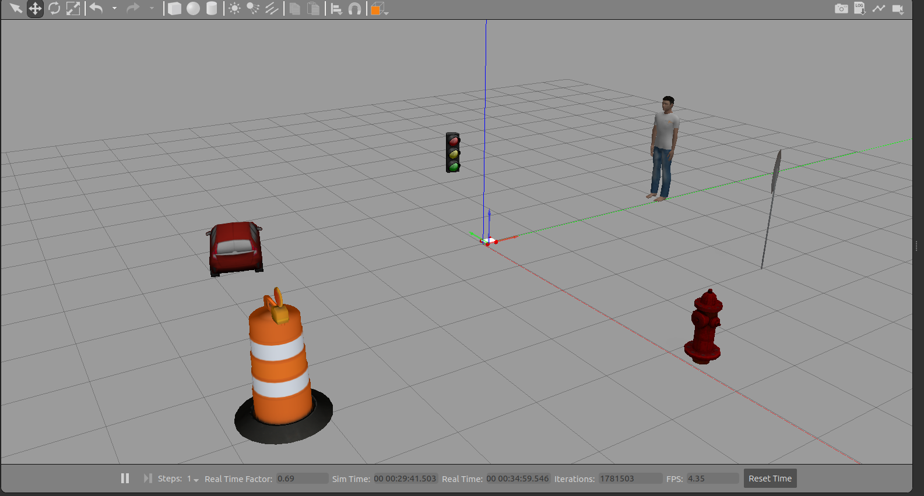
RESULTS:

Slide 8
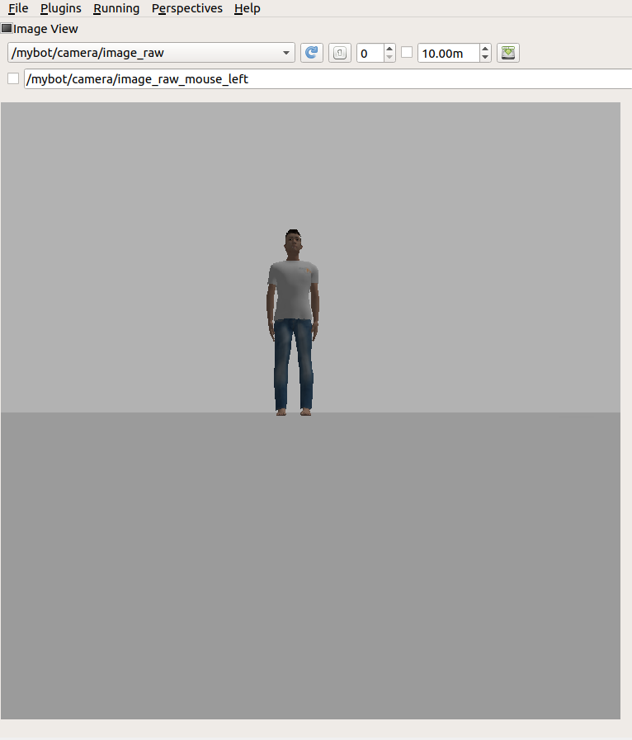
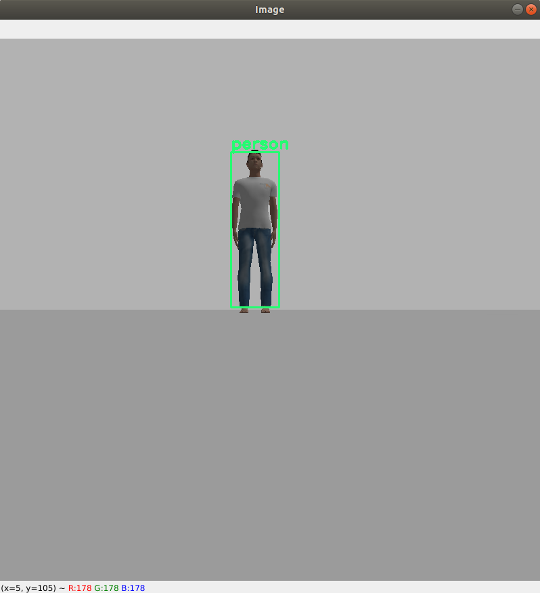

Slide 9
